Slide 1
InfraTech
Interbranch Fusion: Secure & Reliable.
Presented by:
Ahmed Sabry
Ebrahim Mohamed
Shady Hossam
Mohamed Nabawy
Mohamed Elsayed
Date: 13/10/2024

Slide 2

Project Overview
This project aims to establish a fully secure and scalable network infrastructure connecting the headquarters in Cairo and the branch in Paris.
The design focuses on security, redundancy, and efficiency, ensuring seamless connectivity and robust performance across both locations.

Slide 3
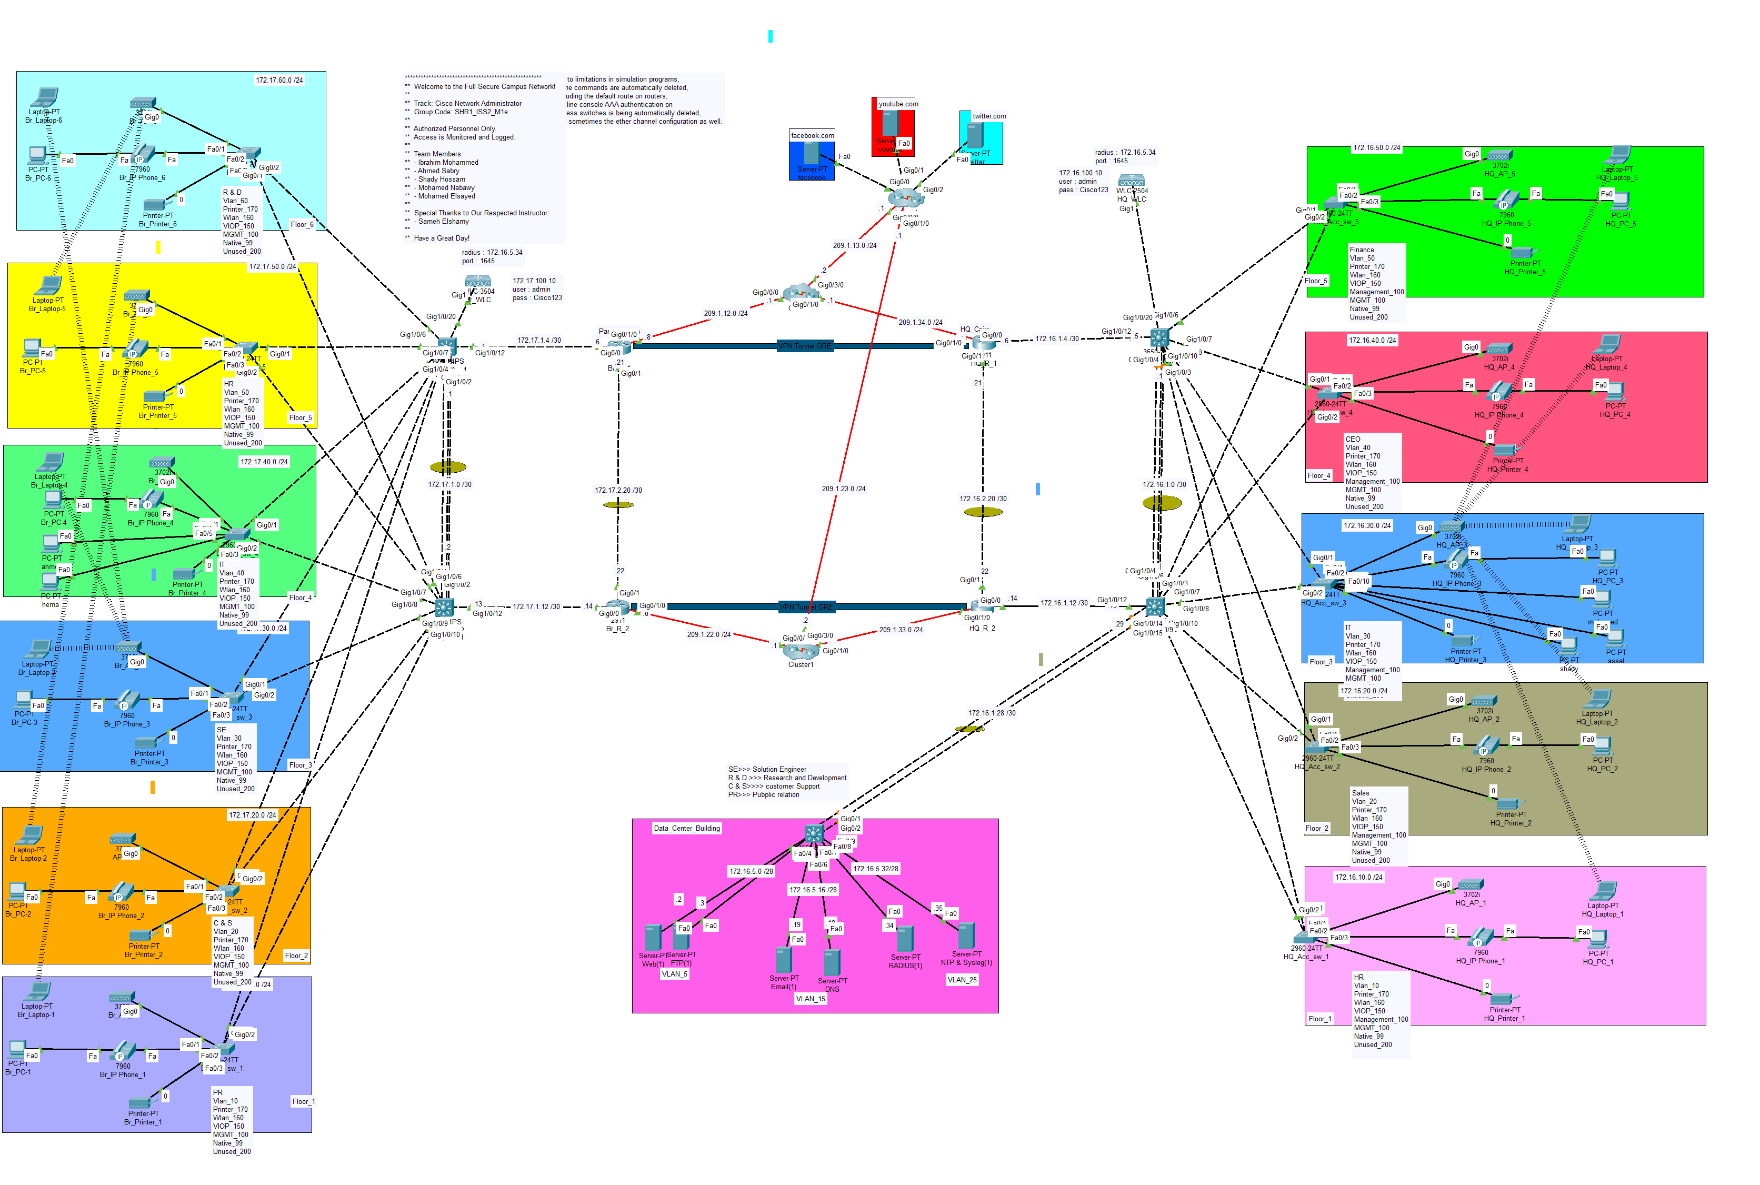
Logical Topology

Slide 4
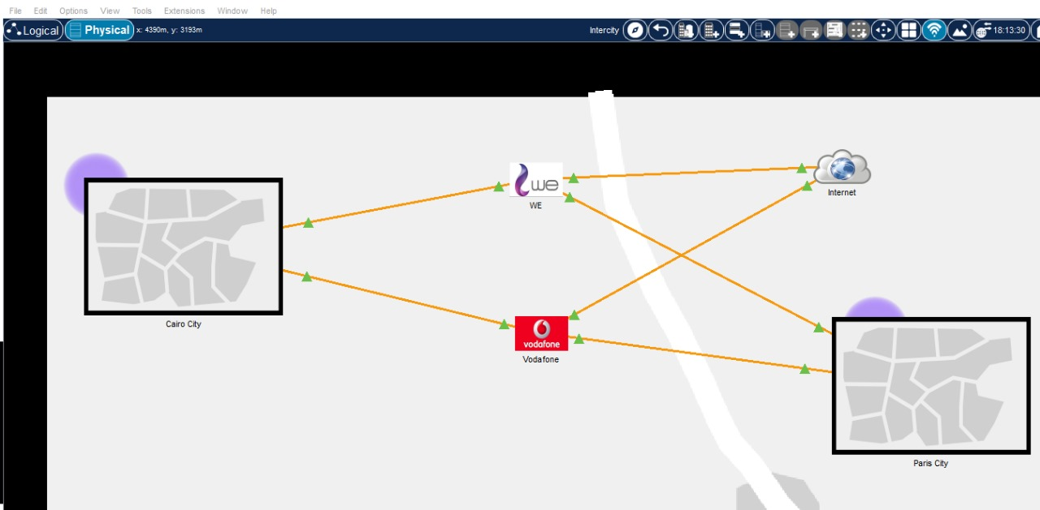
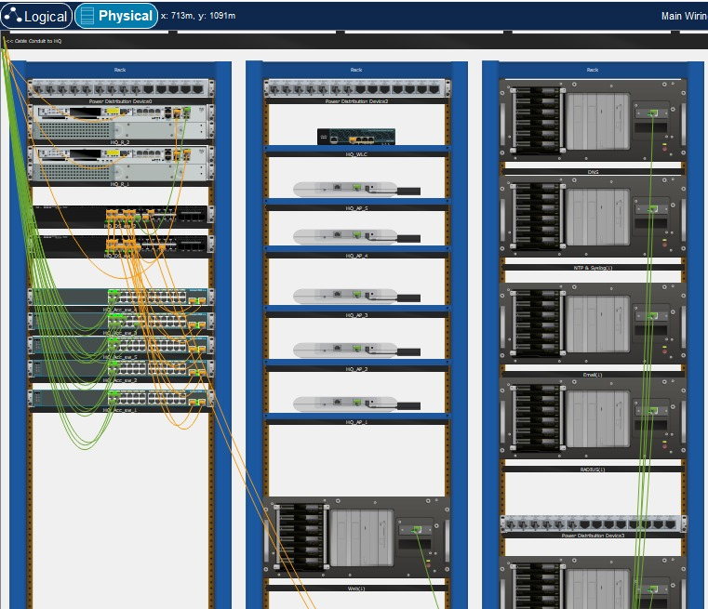
Physical Topology

Slide 5
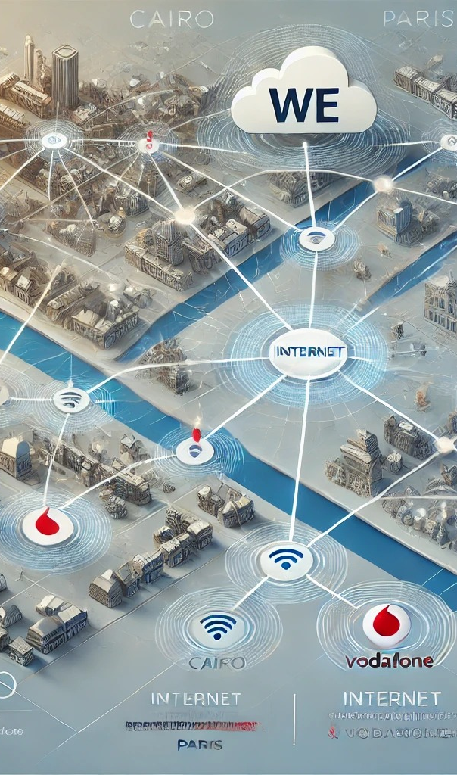
Network Topology Design
The network topology is structured to support both headquarters and branch operations effectively. It consists of Collapsed Core, and Access layers, optimizing data flow and management between multiple devices and locations.
This design ensures high availability and scalability for future expansions.

Slide 6

Subnetting and IP Addressing
Efficient use of IP addresses is achieved through Variable Length Subnet Masking (VLSM). This approach minimizes wasted addresses and allows for flexible scaling.
Each device in the network is assigned an appropriate subnet to enhance routing efficiency and performance.

Slide 7
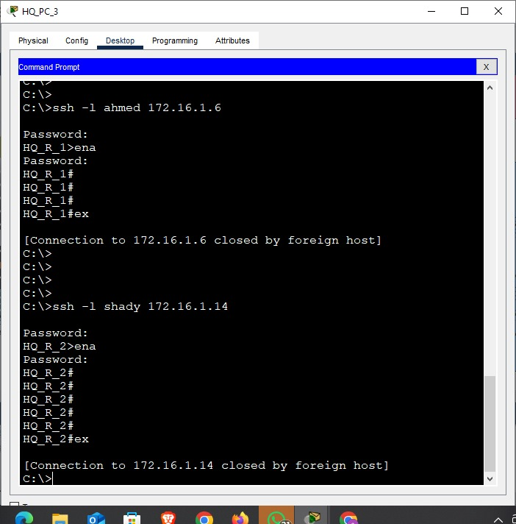
VLAN and SSH Management
Implementing VLANs allows for logical segmentation of the network, enhancing security and performance.
Secure management via SSH ensures that only authorized personnel can access switch configurations, protecting against unauthorized changes.

Slide 8
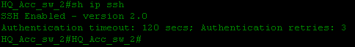
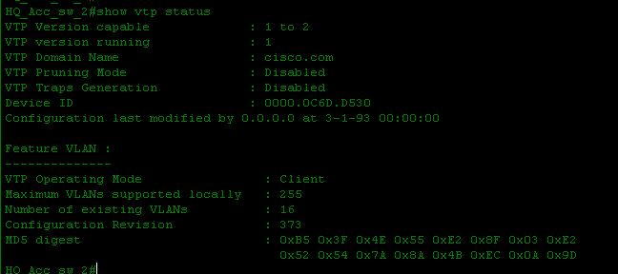
Basic Configuration for Devices
The basic configurations, including SSH, hostnames, and banner messages, establish a standardized environment for all network devices.
Line vty and console settings provide secure access, while VTP ensures consistency in VLAN configurations across switches.

Slide 9
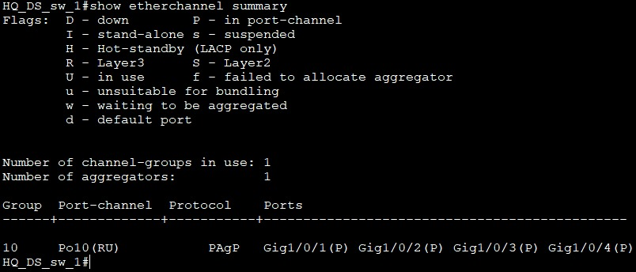
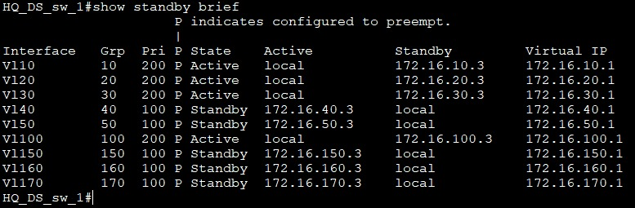
EtherChannel, HSRP
EtherChannel provides increased bandwidth and redundancy by combining multiple physical links between devices into a single logical link. This helps distribute traffic across all links, preventing a single point of failure and enhancing network performance.
HSRP (Hot Standby Router Protocol) ensures high availability for routers and Layer 3 switches by allowing multiple routers to share a virtual IP address. If the primary router fails, the standby router immediately takes over without disrupting network traffic, ensuring continuous availability.

Slide 10
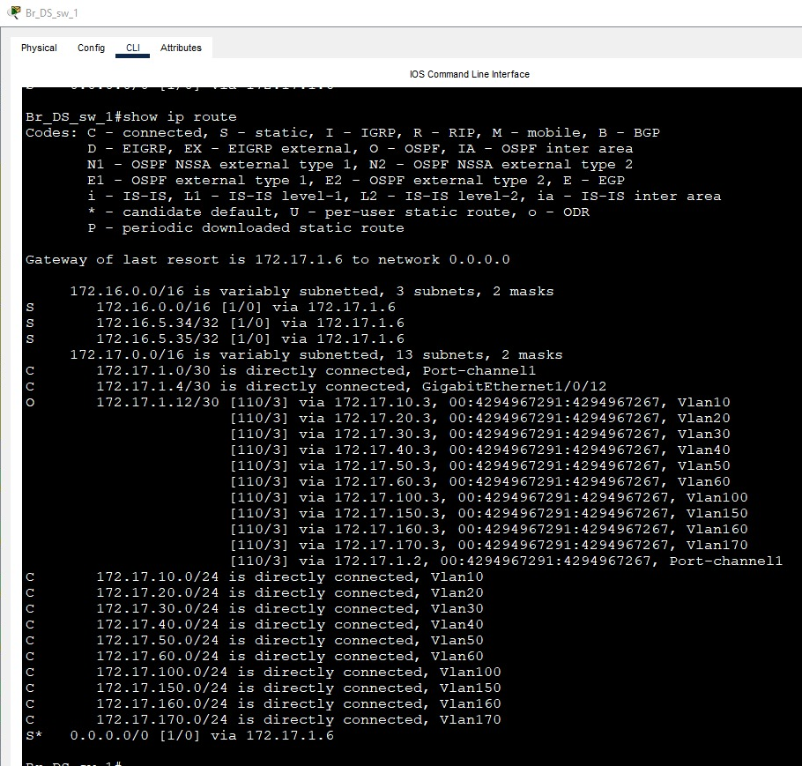
OSPF
OSPF (Open Shortest Path First) is a dynamic routing protocol that efficiently manages data traffic across the network by determining the shortest path for data packets.
It uses a hierarchical structure, with Area 0 serving as the backbone area for the headquarters in Cairo and Area 1 for the branch in Paris. This design improves routing efficiency and scalability by limiting the size of routing tables and minimizing the impact of network changes, ensuring fast and reliable data transfer between both locations.

Slide 11
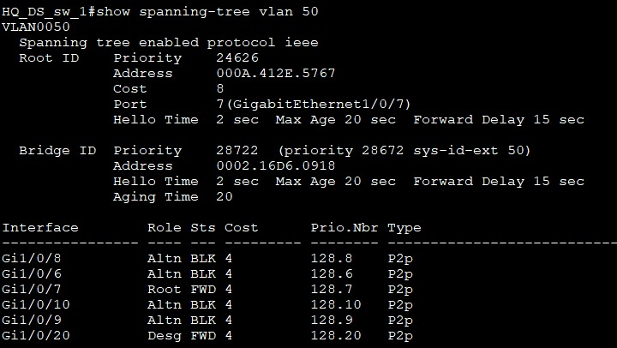
Spanning Tree Protocol (STP) Implementation
STP is essential for preventing loops in a redundant network setup.
This protocol ensures a loop-free topology by designating a root bridge and blocking redundant paths while still allowing for failover scenarios, enhancing network reliability.

Slide 12
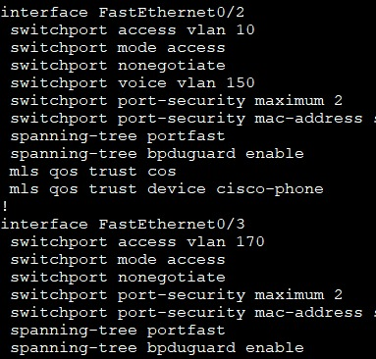
Layer 2 Security Configurations
Implementing port security limits the number of MAC addresses that can be connected to each switch port, mitigating unauthorized access.
BPDU Guard prevents potential disruptions caused by misconfigured switches, enhancing overall network stability.

Slide 13
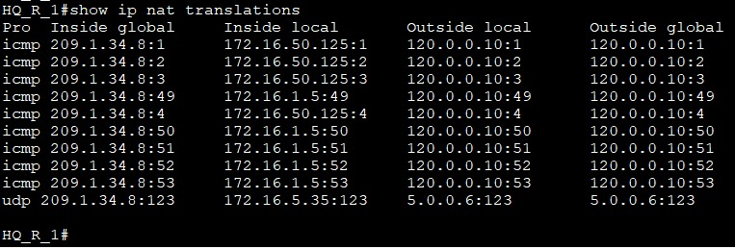
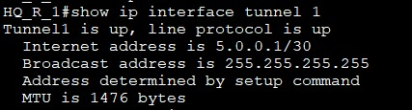
NAT and VPN Configuration
Network Address Translation (NAT) allows internal devices to access the internet while hiding their private IP addresses.
The site-to-site VPN using GRE (Generic Routing Encapsulation) creates a secure tunnel between the headquarters and branch.
GRE supports routing multiple protocols, including multicast and broadcast, making it ideal for flexible communication.

Slide 14
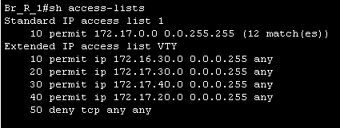
Access Control Lists (ACLs) for Security
ACLs control traffic flow by permitting or denying access based on specific criteria, such as IP addresses.
This enhances security by ensuring that only authorized devices can access critical resources or the internet, thus protecting the network from potential threats.

Slide 15
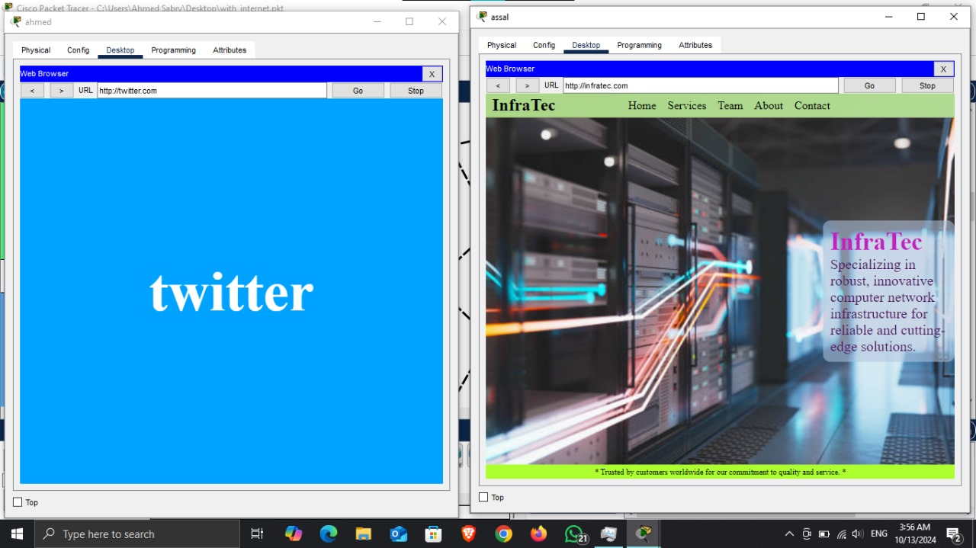
Web Server Implementation
The HTML web server hosts the company's website, providing an interface for clients and employees.
Protocols like HTTP/HTTPS ensure secure data transmission, enhancing user trust and experience.

Slide 16
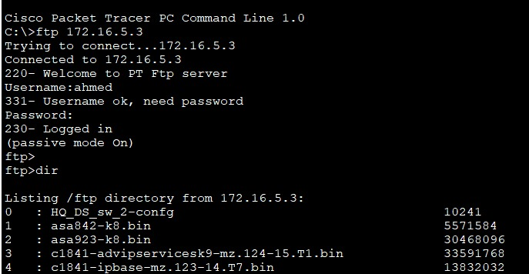
FTP Server Setup
The FTP server enables secure file transfer between devices.
Using protocols like SFTP ensures encrypted file transfers, while user authentication and permissions provide additional security, allowing only authorized users to access files.

Slide 17
Email Server Configuration
The email server supports SMTP for sending emails and IMAP/POP3 for receiving.
It allows users to communicate effectively, with features like spam filtering and email storage management ensuring a smooth email experience.

Slide 18
RADIUS & AAA Server Setup
The RADIUS server centralizes authentication and authorization for network devices, providing a secure method for managing user credentials.
This enhances security by ensuring that only authorized personnel can access sensitive network resources.

Slide 19
NTP & Syslog Server Configuration
The NTP server synchronizes time across all devices, essential for timestamping logs and events.
The Syslog server collects and stores logs for network events, aiding in troubleshooting and monitoring network performance.

Slide 20
DNS Server Configuration
The DNS server resolves domain names to IP addresses, simplifying network navigation for users.
This is critical for accessing services without needing to remember complex IP addresses, enhancing user experience and operational efficiency.

Slide 21
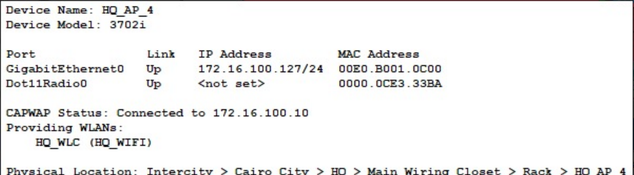
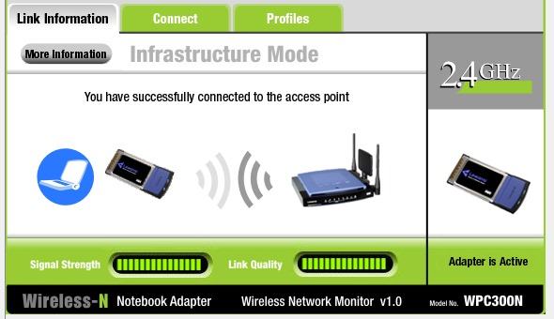
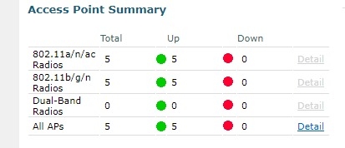
Wireless Configuration
Access points are deployed on each floor, providing robust wireless coverage throughout the headquarters.
A centralized wireless controller manages these access points, ensuring streamlined configuration, monitoring, and security.

Slide 22
Wireless Network Features
The wireless network supports multiple SSIDs, offering secure connections for different user groups.
Advanced security protocols (WPA2/WPA3) protect user data, while load balancing and seamless roaming ensure optimal performance for all users.

Slide 23
Ensuring All Deliverables are Complete
A comprehensive verification process ensures all configurations and setups are completed.
This includes validating network security, redundancy, and performance through rigorous testing and documentation for future reference.

Slide 24

Conclusion and Future Enhancements
This project establishes a solid foundation for a secure and efficient network infrastructure.
Future enhancements may include exploring advanced security measures, scaling the network, and adopting new technologies to meet evolving organizational needs.

Slide 25

Thanks

